Slide 1
Putting the ‘CASTLE’ back into NORTHAMPTON ^ STATION
The Friends of Northampton Castle
Aiming for Northampton’s past to play a part in our future
Notes:
Themes covered in this presentation
Architecture
Archaeology
Civic Pride
Culture
Geography – urban, topography
Heritage
History – local, social, economic
Literature

Slide 2
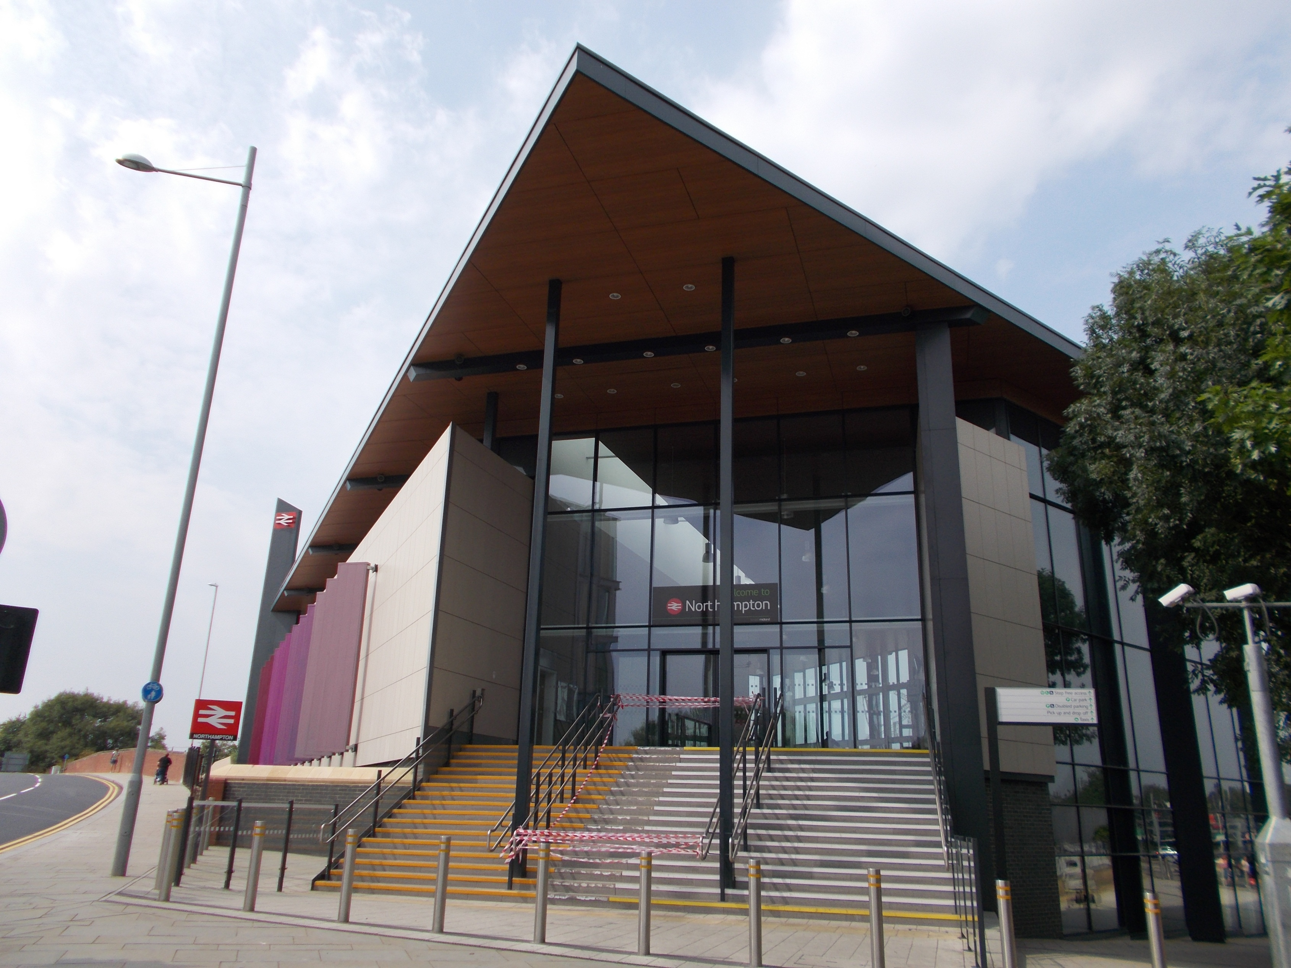
Notes:
Northampton’s new bright and modern railway station
Opened in 2015.
But, as with all change , not everyone is pleased with the new station.
It replaced……

Slide 3
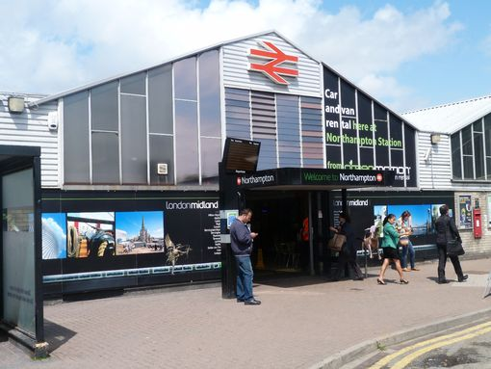
Notes:
……….This building.
Built in the mid 1960’s.
Not everyone liked this building either when it was first opened.
It replaced a building that was over 80 years old…….

Slide 4
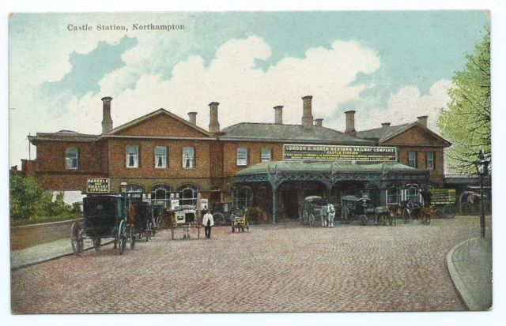
Notes:
……..This Victorian station.
Opened in 1880, same time as the ‘Northampton Loop’ giving the town direct rail access to the London-Birmingham main line.
It replaced the first simple station, a covered platform with no facilities, which served the Northampton to Market Harborough line that started in 1859.
It was a larger better station nearer to the town centre.
AND…….Not everyone was pleased with the new building!
In fact the townsfolk were very unhappy and even drew up a petition to try to stop it being built.
But why were they so unhappy?
Maybe because there were already two other railway stations in town.
Bridge Street - opened in 1845- (Blisworth to Peterborough line).
St. John’s Street - opened in 1872 – (Northampton to Bedford line).
OR……Take a closer look at the picture.
See……… it is called ‘Castle Station’
WHY?...........

Slide 5
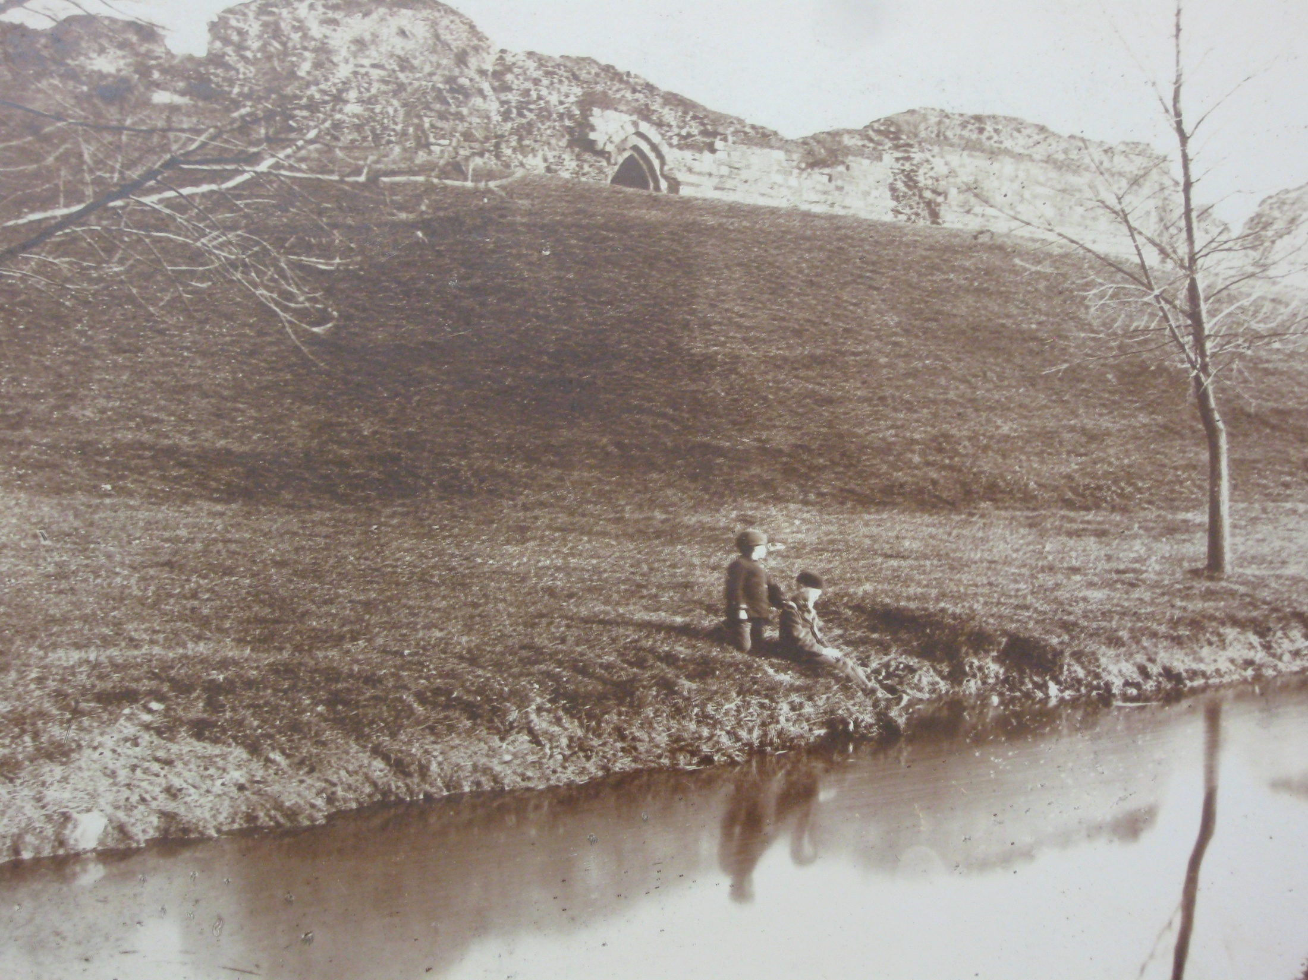
Notes:
……This is why!
This photograph is nearly 150 years old.
It shows the ruined remains of the once mighty Medieval Northampton Castle.
The site of many Great Councils/early parliaments; where laws were passed, treaties signed, money raised for wars, and royal justice handed out.
A picturesque site. Ideal for picnics and as the picture shows for fishing.
The original simple ‘Castle’ station had been built on part of one of the orchards that had been planted in the grounds of the old castle.
Please note
In 1863 E. Law & son (W. Law) surveyed the castle. Around 1870 W. Law took a number of photographs of the Castle remains. The surviving photographs are held by Northamptonshire Libraries and Information Services. They are available to view in the Central Library and also on the Friends of Northampton (FONC) web-site www.NorthamptonCastle.com

Slide 6
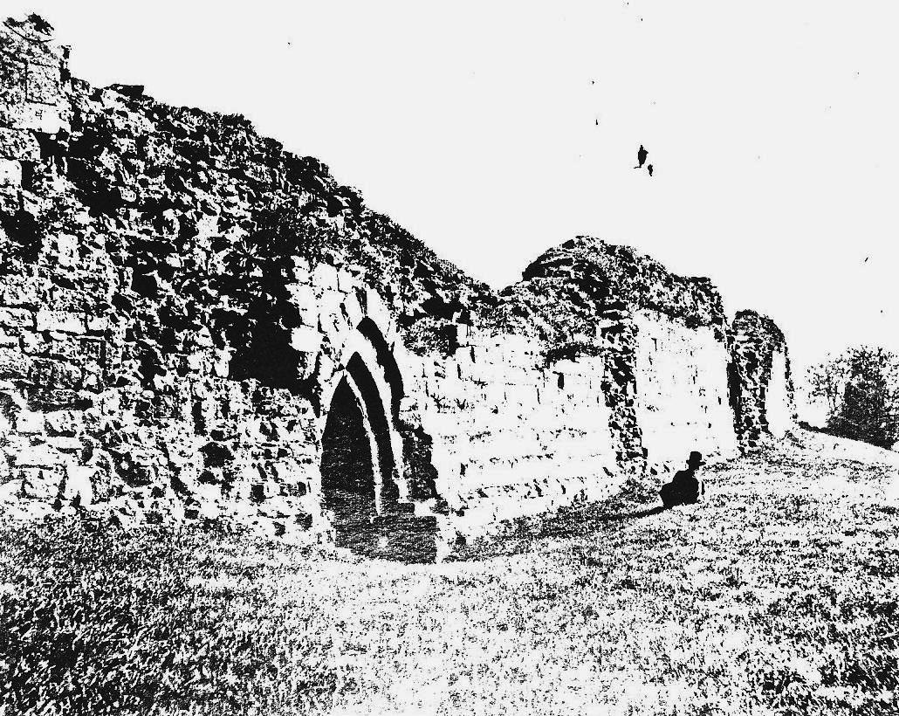
Notes:
Here is another old photograph of the castle ruins.
It shows the last remaining castle postern gate.
All the visible ruins of the castle were cleared and the land flattened in the 1870s to make way for the construction of the ‘Northampton loop’, new railway station, and a large goods yard.
Even the river was diverted.
Look at a modern map of the town…..
…….you will see that the river near to the railway station becomes straight, like a canal.
All trace of the castle on the railway station site gone……
……or maybe not……

Slide 7
The Postern Gate
Notes:
The Postern Gate still stands!
It is near to the entrance of the railway station.
Do you think it looks the same as the one in the old photograph?
Due to the local outcry in the town over the demolition of the castle ruins, the Postern Gate was moved and rebuilt in its present position.
Do you think that it is a fitting keepsake of the mighty castle?
Notice the richly coloured sandstone.
Many old buildings in Northampton have the same coloured stone ‘recycled’ from the castle.
Look around the town. Stones from the castle are everywhere.

Slide 8
Northampton Station
1960’s Building
Northampton Castle Station
Victorian Building - Circa 1900
Notes:
Lets take a closer look at the pictures of the previous station buildings.
See the tarmac near the 1960’s building,
and
The cobbles on the road leading to the Victorian building.

Slide 9
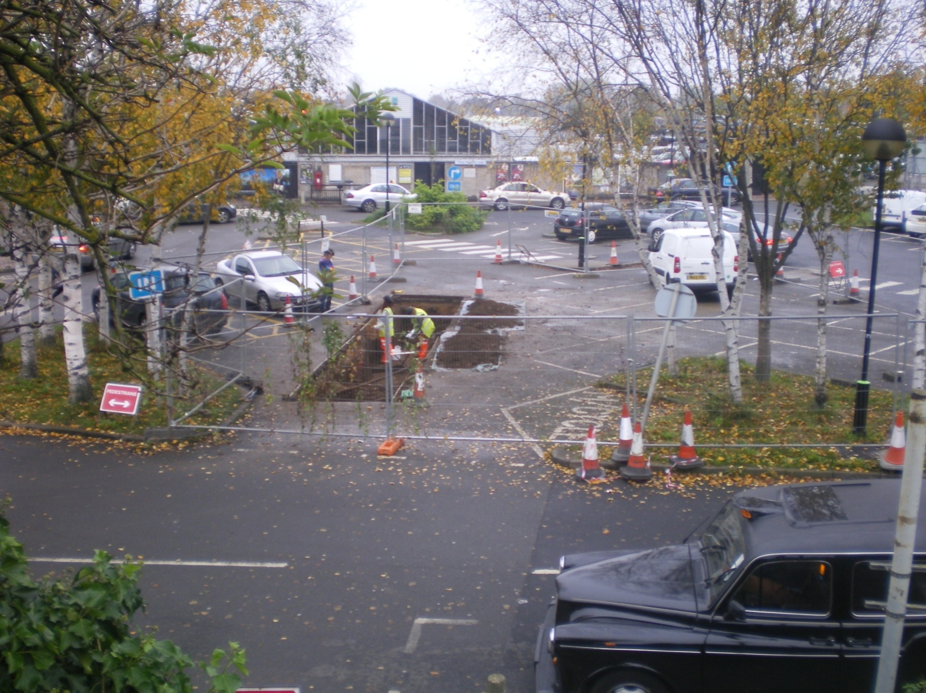
Notes:
This is a photograph, taken in the autumn of 2012 of the old 1960’s station. prior to building work starting on the new station.
Take a closer look at the photo.
Archaeologists from the Northamptonshire Archaeology Unit are digging a trial trench in the station’s short-stay carpark.
Please Note
Northamptonshire Archaeology transferred to Museum of London Archaeology (MOLA) in 2014.
Please visit www.mola.org.uk for more information

Slide 10
The Victorian cobbles lie under the thin layer of tarmac
Under the cobbles a 12th century wall & further down
Late Anglo Saxon finds
Notes:
A close-up of the trial trench
You can clearly see that a thin layer of tarmac was laid over the Victorian cobbles.
The archaeologists soon found under this surface a ironstone wall and pottery dated circa 12th century.
Further down late Anglo Saxon finds included a rare designed brooch.
So in the spring of 2013, they dug an even bigger hole! ……

Slide 11
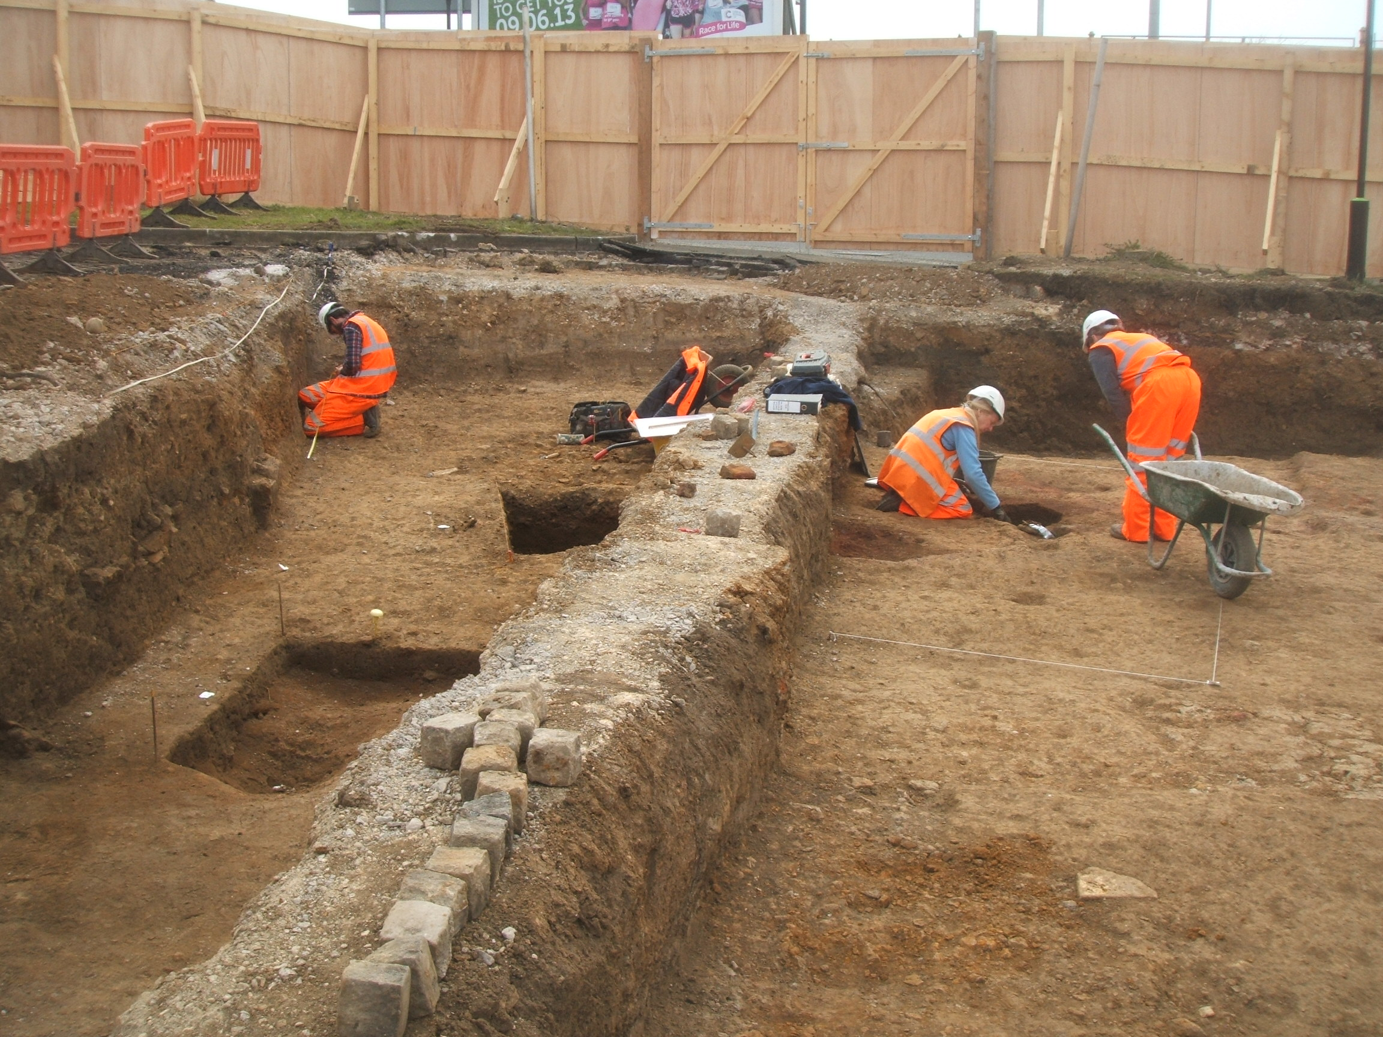
Notes:
The larger excavated area of the station’s concourse
An area that would have been within the castle’s outer bailey.
The archaeologists unearthed the rest of the building attached to the 12th century wall.
They think the building was perhaps a smithy, used for ironwork or a farriery (blacksmith).
They also found:
10th & 11th century late Anglo-Saxon ditches and pits.
Bits of pottery.
Large deposits of animal bone.
Parts of other walls that may possibly have formed a postern gate leading to the medieval west bridge.
After every detail had been recorded and photographed, the hole was carefully filled in so work on the new station could commence.

Slide 12
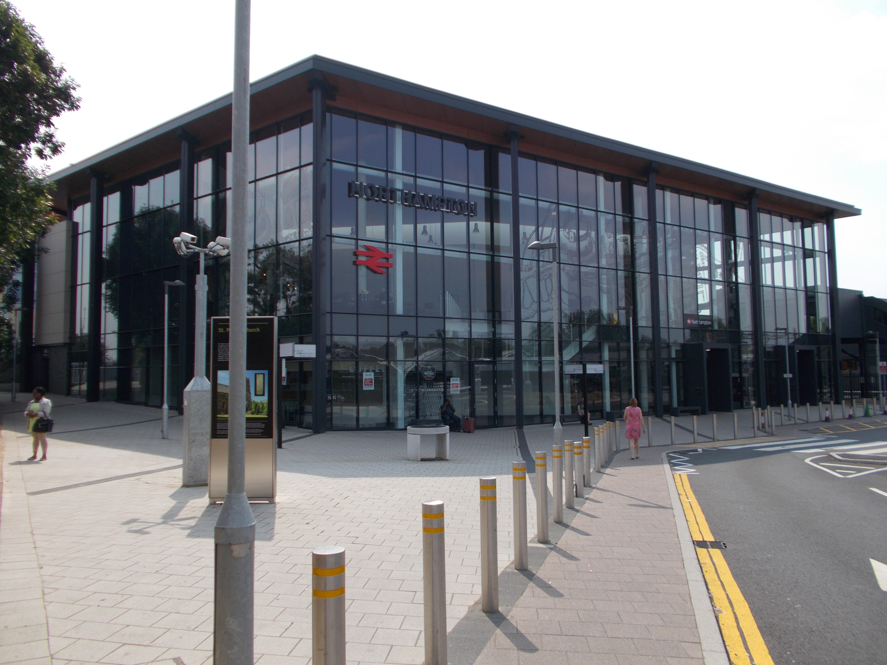
Notes:
The Friends of Northampton Castle (FONC) lobbied hard during the planning and building of the new railway station for the castle to be referenced and celebrated in the design.
Regrettably, the push to have ‘Castle’ reinstated in the station’s title was not successful.
However, commuters and visitors passing through the building and concourse today can….
See many references to the castle,
and
Read the various information boards on the historical significance of the castle, the site, and town.
For example……the etching of John Speed’s map on the glass wall of the building……and…….

Slide 13
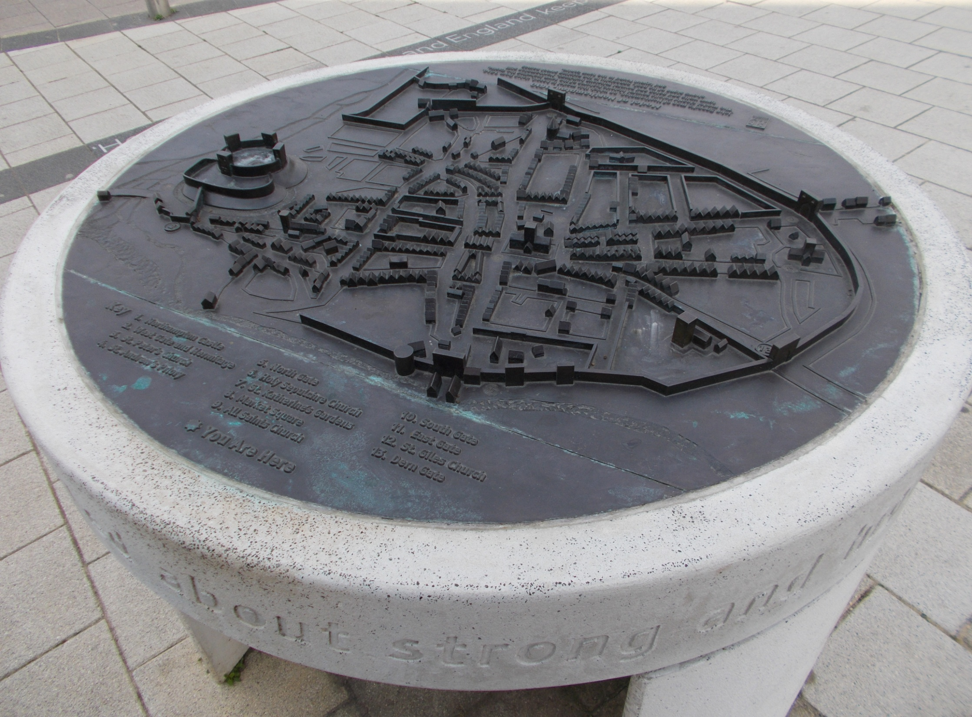
Notes:
Model of Speed’s map of Northampton situated on the concourse of the new railway station
John Speed is famed for his exquisite map making in the early 17th century.
His 1610 map of Northamptonshire includes a small insert of Northampton.
The town wall, castle and gates are clear to see.
The map also names major features such as the churches and the town gates.
This map is referenced around the new station.

Slide 14
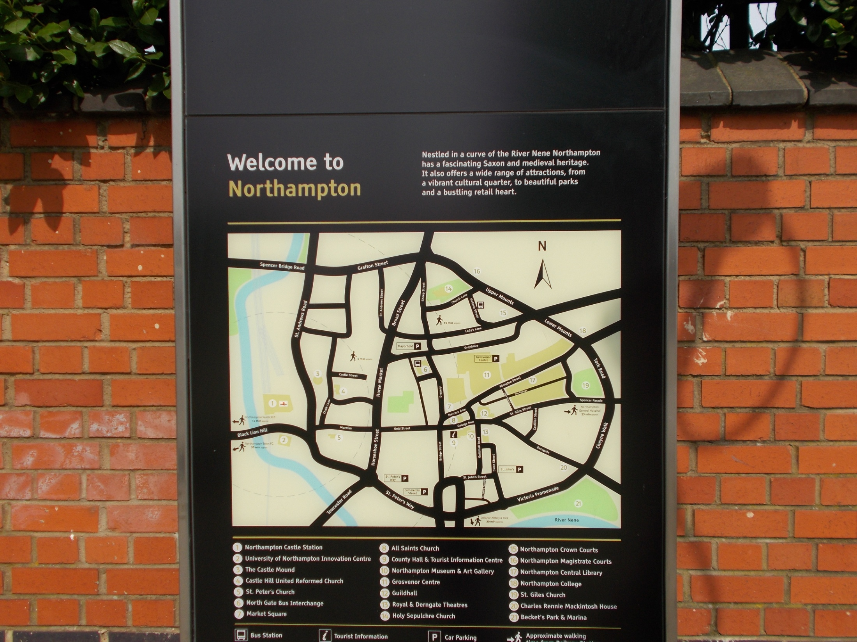
Notes:
Information map of the town centre
Does the shape of the road system round the town centre look familiar?
Compare the modern day map to Speed’s map of Northampton.
You will see that the modern road system follows very closely the position of the town’s old walls in Speed’s map.
You can get a sense of the size of Medieval Northampton.

Slide 15
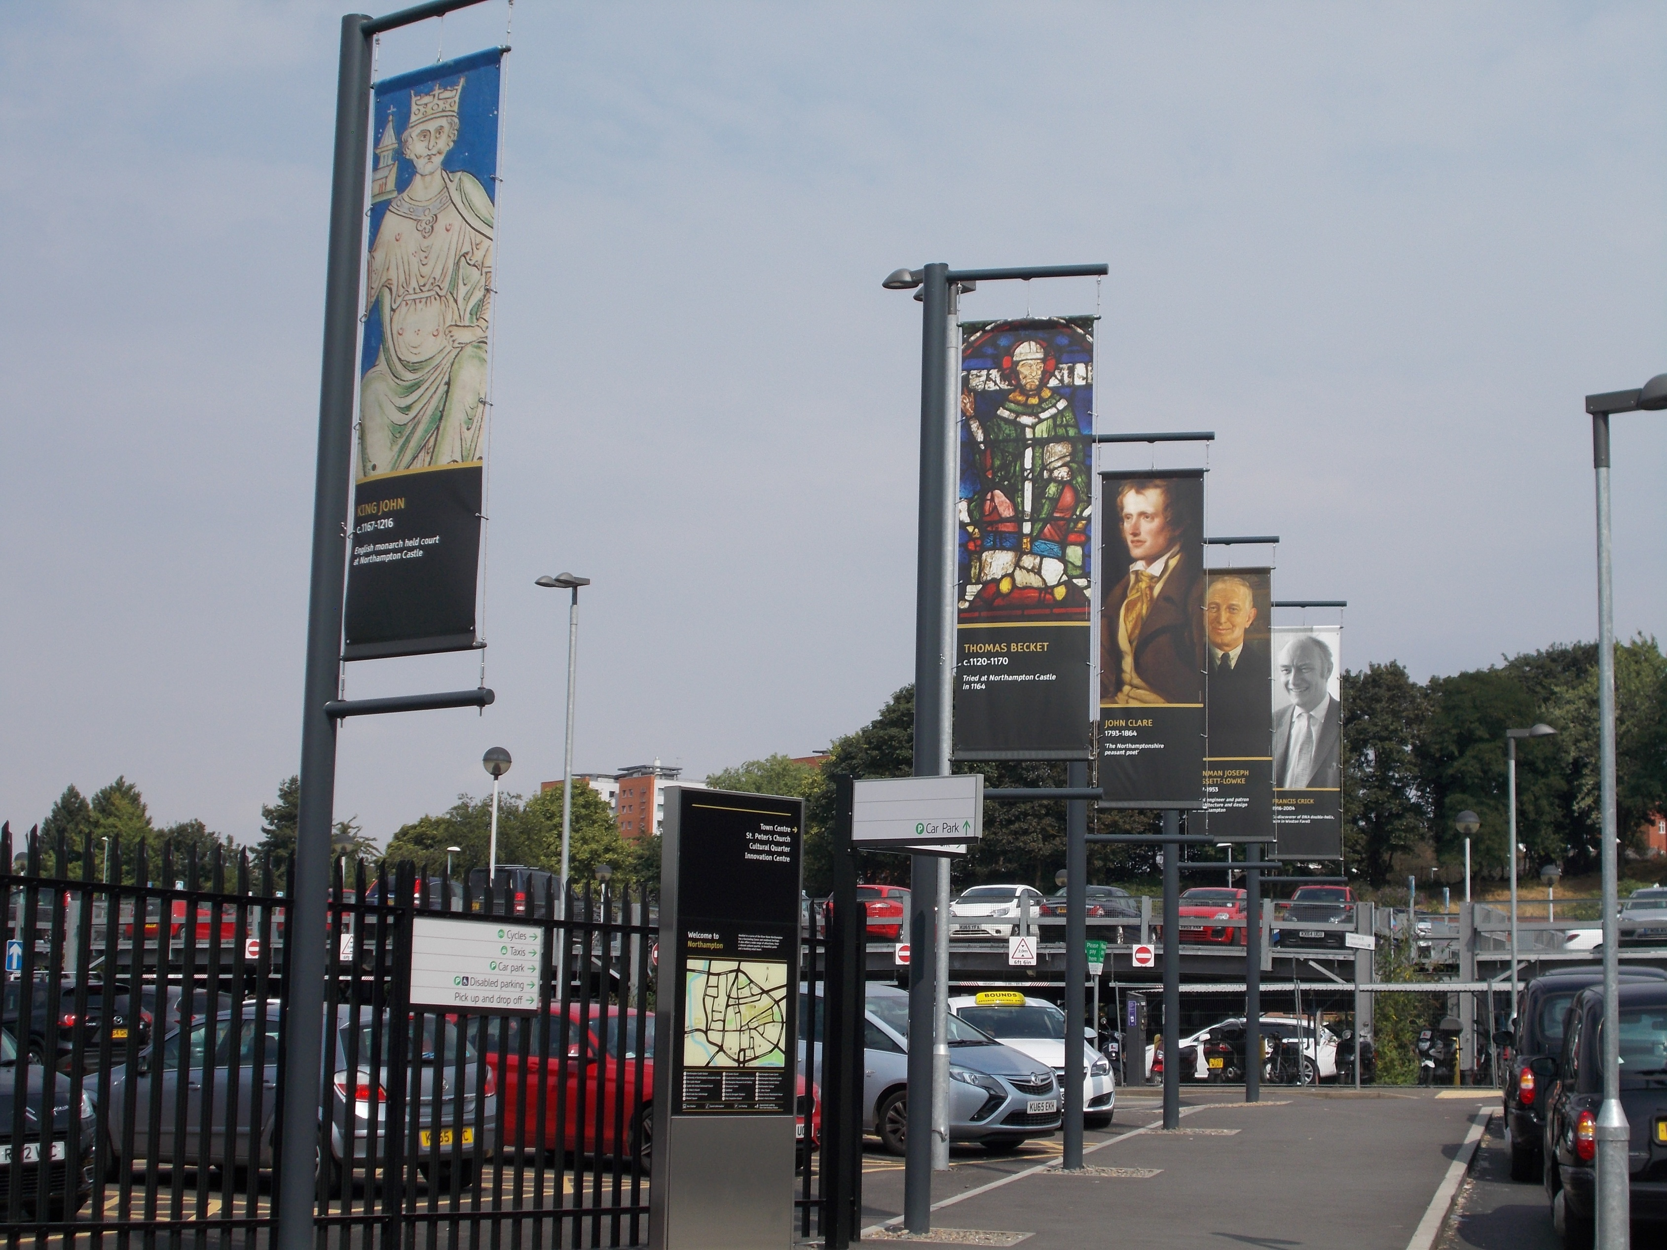
Notes:
Banners, situated near the station’s taxi rank, depicting ten famous people associated with Northamptonshire
They also have a link with the castle…..
Thomas Becket – stayed and also tried at the castle.
King John – frequently stayed at the castle.
Eleanor of Castile – would have stayed at the castle.
Elizabeth Woodville – probably visited the castle.
John Clare – would have wandered amongst the castle ruins.
Caroline Chisholm – grew up in the nearby Mayorhold area,
so the castle ruins would have been her local playground.
Wenhan Joseph Bassett-Lowke
Walter Tull all would have caught
Francis Crick a train from
Sir Malcolm Arnold ‘Castle Station’
Who would you choose as your ten famous Northamptonians?

Slide 16
Notes:
Part of a large information board timelining Northampton’s history, situated on the passageway from the concourse to the main road
Quotes from Shakespeare’s play King John are etched in the pavement of the station concourse.
Northampton Castle is the setting for all of Act IV of the play.
The scenes enacting the final days and death of Arthur of Brittany at the Castle are not historically accurate (location should be in France).
King John’s many stays at the Castle are well recorded and therefore a fitting dramatic location.
Shakespeare’s plays are themselves history……… play on!
So hopefully, anyone passing through Northampton Station should leave with the knowledge that it is built on the site of a once magnificent and important Medieval Castle.

Slide 17
Friends of Northampton Castle (FONC)
www.northamptoncastle.com
Notes:
Next time you are passing through the railway station take time to look at all the references to the castle and read the information boards.
Imagine:
How different the area would have been in Medieval times.
If the ruins had survived, how the area could have looked today.
And
How you would celebrate Northampton’s Heritage?
The Friends of Northampton Castle thank you for your interest.

